Slide 1

Divorce code
Predicting divorce
Kabir Ramana
Rodrigue Gbedomon
Sertac Balbaros

Slide 2
Trends of divorce in Switzerland and around the world

Slide 3
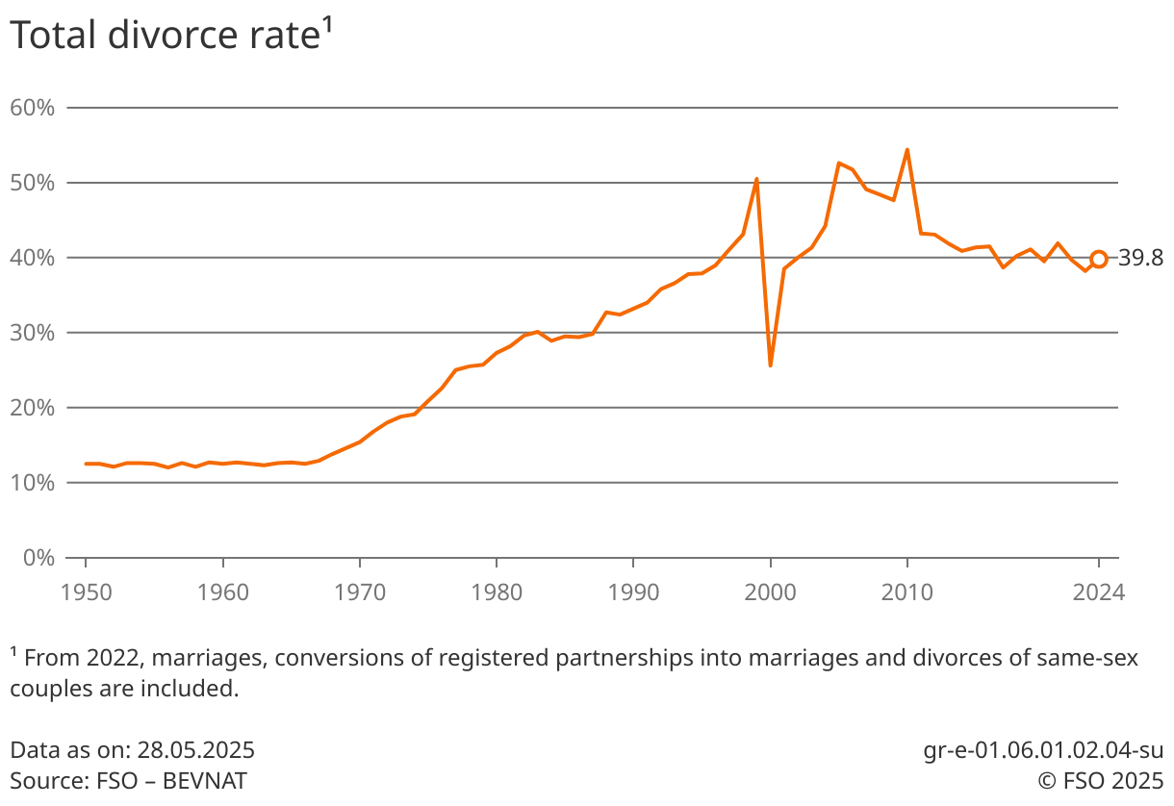
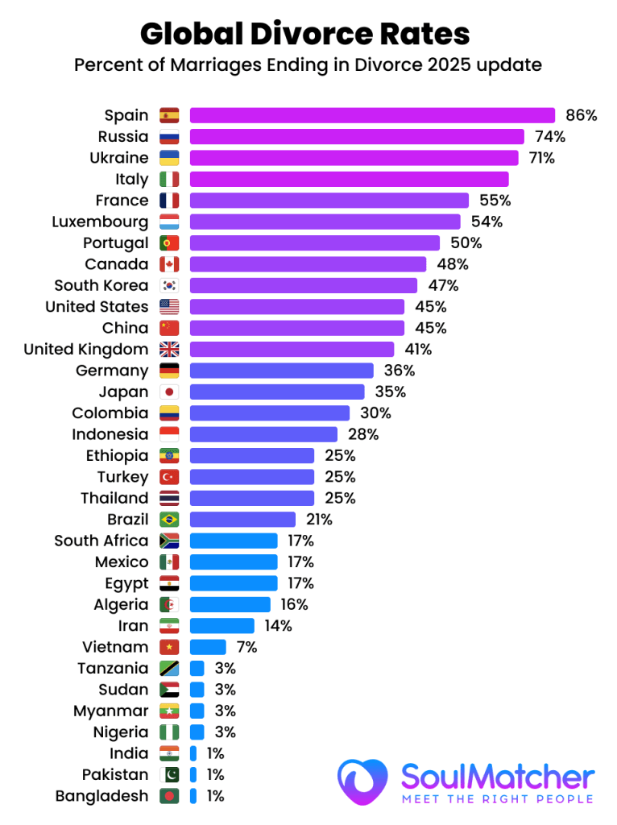
in Switzerland
Total divorce rate (TDR)
Fig 2. Evolution of the total divorce rate in switzerland
TDR vary considerably over time and from country to country and region to region
Fig 3. Total divorce rate in 2025

Slide 4
Research interest (Research Project)

Slide 5

Develop predictive models of divorce using multidimensional determinants, and identify the key factors that most strongly contribute to marital dissolution.

Slide 6
Which models offers the most reliable prediction of divorce?
Which factors contribute most to predicting divorce ?

Slide 7
Research interest
(for deep learning Module)

Slide 8
Summary of ML results
--- Model1 (Logistic Regression) ---
Accuracy on Test Set: 0.6150
--- Confusion Matrix ---
Predicted 0 | Predicted 1
Actual 0: 537 | 65
Actual 1: 323 | 75
Classification Report:
precision recall f1-score support
0 0.62 0.89 0.73 602
1 0.54 0.19 0.28 398
--- Model 2(Random Forest Classifier) ---
Accuracy on Test Set: 0.6100
--- Confusion Matrix ---
Predicted 0 | Predicted 1
Actual 0: 542 | 60
Actual 1: 333 | 65
Classification Report:
precision recall f1-score support
0 0.62 0.90 0.73 602
1 0.52 0.16 0.25 398
--- Training Model (XGBoost Classifier) ---
Accuracy on Test Set: 0.5900
--- Confusion Matrix ---
Predicted 0 | Predicted 1
Actual 0: 482 | 120
Actual 1: 294 | 104
Classification Report:
precision recall f1-score support
0 0.63 0.82 0.71 602
1 0.49 0.25 0.33 398
Moderate accuracy (56% à 62%)
Good performance for Class 0, so fine in predicting No divorce
Poor performance for Class 1, bad in predicting divorce

Slide 9
Reasons for underperformance of ML models
Small, imbalanced, and heterogeneous datasets
Low signal-to-noise ratio in available data
Limited capacity of models (Non-linear interactions)
60 / 40 mild imbalance but not extreme
Depends on the dataset
Increase capacity of models (Deep learning)

Slide 10
Research objective with deep learning
Leverage deep learning to improve the prediction and understanding of divorce by capturing complex, latent, and dynamic relationship patterns.

Slide 11
Exploratory Data Analysis (EDA) – Dataset Overview

Slide 12
Data provenance and structure
Data source: https://www.kaggle.com/datasets/vanpatangan/divorce-prediction/data
Data structure:
5,000 couples
5 dimensions
22 Variables (21 features + 1 target variable)
1.Demographic and Family Structure | 2.Socioeconomic Conditions | 3.Interpersonal Relationship Dynamics | 4.Psychological and Behavioral Factors | 5.Support System
·age_at_marriage ·marriage_duration_years ·num_children ·marriage_type ·pre_marital_cohabitation ·religious_compatibility ·cultural_background_match | ·education_level ·employment_status ·combined_income | ·communication_score ·conflict_frequency ·conflict_resolution_style ·trust_score ·shared_hobbies_count | ·financial_stress_level ·mental_health_issues ·infidelity_occurred ·domestic_violence_history | ·counseling_attended ·social_support

Slide 13
Summary statistics
This table summarizes the distribution of key numerical variables using mean, standard deviation and range.
 | Age at Marriage | Marriage duration | num_children | combined_income | communication_score | Conflict frequency | financial_stress | social_support | trust_score
Mean | 27.58 | 9.17 | 1.55 | 60220 | 6.04 | 2.00 | 5.07 | 5.97 | 6.03
std | 4.85 | 8.84 | 1.24 | 19662 | 1.96 | 1.41 | 2.33 | 1.97 | 1.93
Min | 18.00 | 1.00 | 0.00 | 10000 | 1.00 | 0.00 | 1.00 | 1.00 | 1.00
25% | 24.00 | 2.00 | 1.00 | 46666 | 4.66 | 1.00 | 3.37 | 4.60 | 4.70
50% | 28.00 | 6.00 | 1.00 | 60196 | 6.06 | 2.00 | 5.06 | 6.01 | 6.03
75% | 31.00 | 13.00 | 2.00 | 73666 | 7.43 | 3.00 | 6.72 | 7.33 | 7.37
Max | 45.00 | 40.00 | 6.00 | 126909 | 10.00 | 9.00 | 10.00 | 10.00 | 10.00

Slide 14
Summary statistics
This table shows the distribution of key binary variables in the dataset. Each variable contains 5,000 observations.
 | Cultural Background Match | Mental health issue | Infidelity occurred | Counseling attended | Pre Martial Cohabitation | Domestic violence | divorce
Count | 5000 | 5000 | 5000 | 5000 | 5000 | 5000 | 5000
Yes | 3777 | 1019 | 745 | 1202 | 2961 | 252 | 1191
No | 1223 | 3981 | 4255 | 3798 | 2039 | 4748 | 3009
Most couples did not experience infidelity (4,255 cases)
A large proportion reported no mental health issues (3,981 cases)
Pre Marital cohabitation is common (2,961 Yes cases)

Slide 15
Summary statistics
 | Variable | Category | Count
 | Education Level | Bachelor | 2069
 |  | High School | 1513
 |  | Master | 963
 |  | No Formal Education | 231
 |  | PHD | 224
 | Employment Status | Full-time | 2487
 |  | Part-time | 1028
 |  | Homemaker | 748
 |  | Unemployed | 737
 | Marriage Type | Love | 3513
 |  | Arranged | 1231
 |  | Other | 256

Slide 16
Summary statistics
📌 Key observations:
Most participants have a Bachelor’s degree (2069)
The majority are full-time employed (2487)
Love marriage is dominant (3513 cases)
Most couples share the same religion (3040 cases)
Collaborative conflict style is the most common (2028 cases)
 | Variable | Category | Count
 | Religious Compatibility | Same religion | 3040
 |  | Not religious | 1003
 |  | Different religion | 957
 | Conflict Resolution Style | Collaborative | 2028
 |  | Avoidant | 1250
 |  | Aggressive | 994
 |  | Passive | 728

Slide 17
Data analyses

Slide 18
Data analyses
🟦 Machine Learning Models
Logistic regression
Random Forest
XGBoost
🟪 Deep Learning Models
Deep Feed Forward Neural Network
Tabnet
Deep learning Pipeline
Data Preparation
Model Definition
Training
Improvement
Evaluation

Slide 19
Results

Slide 20
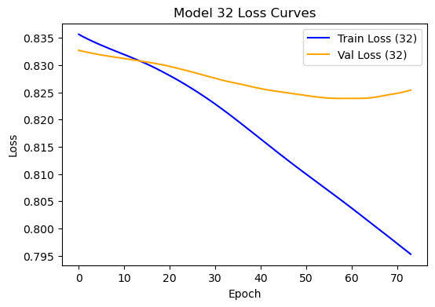
Model 1 (Deep Feed Forward 32 Neurons)
--- Training Model (Deep Learning Model) ---
Accuracy on Test Set: 0.57
--- Confusion Matrix ---
Predicted 0 | Predicted 1
Actual 0: 544 | 49
Actual 1: 340 | 67
Classification Report:
precision recall f1-score support
0 0.66 0.58 0.62 602
1 0.46 0.55 0.50 398
Key Observations: Training Loss - Keeps steadily decreasing and the model is continuously improving
Validation Loss - It decreases at first, then flattens out and begins to increase slightly, indicating that the model is overfitting.

Slide 21
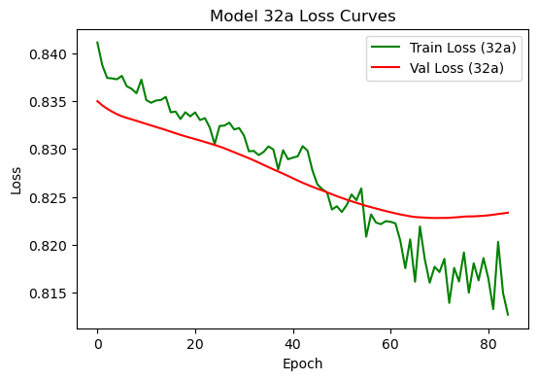
Model 1 (Deep Feed Forward 32 Neurons, with regularization and early stopping)
--- Training Model (Deep Learning Model) ---
Accuracy on Test Set: 0.58
--- Confusion Matrix ---
Predicted 0 | Predicted 1
Actual 0: 544 | 49
Actual 1: 340 | 67
Classification Report:
precision recall f1-score support
0 0.65 0.59 0.62 602
1 0.46 0.53 0.49 398
Key Observations: Training Loss - There is a decreasing trend that indicates that the dataset is noisy
Validation Loss - Decreases at first then flattens and slightly increases
Both curves go down → Indicating that training keeps on improving and validation stops improving

Slide 22
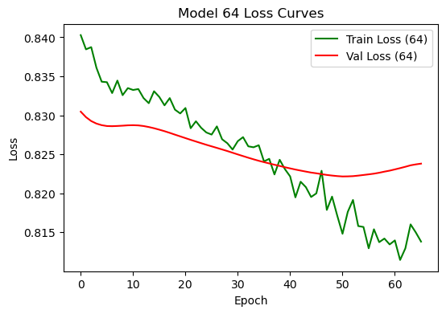
Model 1 (Deep Feed Forward 64 Neurons)
--- Training Model (Deep Learning Model) ---
Accuracy on Test Set: 0.56
--- Confusion Matrix ---
Predicted 0 | Predicted 1
Actual 0: 545 | 49
Actual 1: 340 | 67
Classification Report:
precision recall f1-score support
0 0.67 0.58 0.62 602
1 0.47 0.57 0.51 398
Key Observations: Training Loss - There is a decreasing trend that indicates that the dataset is slightly noisy but normal. Ends lower then validation
Validation Loss - Decreases initially but the training keeps improving and validation gets worse

Slide 23
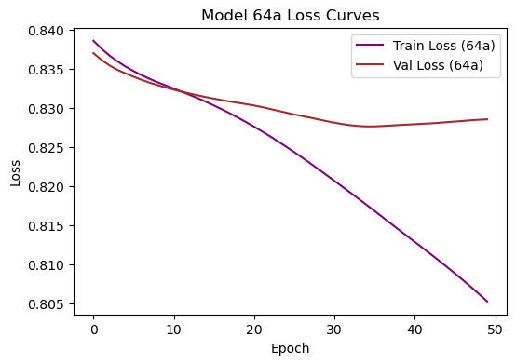
Model 1 (Deep Feed Forward 64 Neurons, with regularization and early stopping)
--- Training Model (Deep Learning Model) ---
Accuracy on Test Set: 0.57
--- Confusion Matrix ---
Predicted 0 | Predicted 1
Actual 0: 367 | 235
Actual 1: 193 | 205
Classification Report:
precision recall f1-score support
0 0.66 0.61 0.63 602
1 0.47 0.52 0.49 398
Key Observations: Training Loss - Steadily decreases throughout training.
This means the model is continuously getting better at fitting the training data.
Validation Loss - The curve drops at the start, indicating that the model is generalizing well and learning underlying patterns from the data.

Slide 24
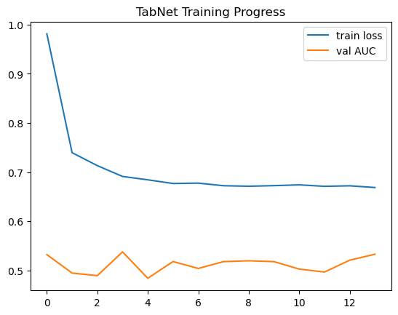
Model 2 (Tabnet)
--- Training Model (Deep Learning Model) ---
Accuracy on Test Set: 0.59
--- Confusion Matrix ---
Predicted 0 | Predicted 1
Actual 0: 570 | 32
Actual 1: 371 | 27
Classification Report:
precision recall f1-score support
0 0.61 0.95 0.74 602
1 0.46 0.07 0.12 398
Key Observations: Training Loss - Drops very quickly at the start (≈0.98 → ≈0.70 in a few epochs) and then flattens out around ~0.67
Validation Loss - The curve fluctuates quite a lot and there is no trend that indicates that it’s increasing

Slide 25
Conclusion

Slide 26
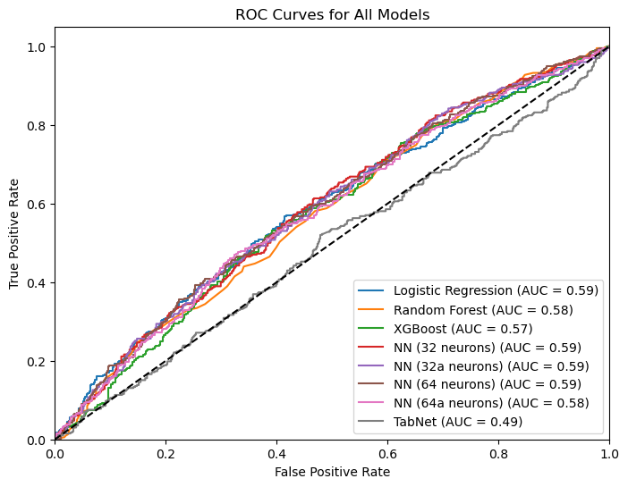
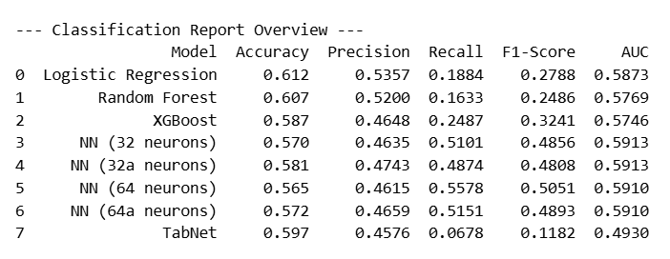
Comparison of the models

Slide 27

5. Conclusion
Across all models,
predictive quality is modest,
detection of non divorce cases is moderate
detection of divorce cases is modera.
The models require
rebalancing,
feature enhancement

